Slide 1
4: SQL –Basic Query
Database System Concepts
Abraham Silberschatz, Henry F. Korth, S. Sudarshan
&
Oracle database SQL Reference

Slide 2
Basic SQL Query
Basic Query Structure
Additional Basic Operations
Set Operations
Null Values
Aggregate Functions
Nested Subqueries
Modification of the Database
Notes:
1

Slide 3
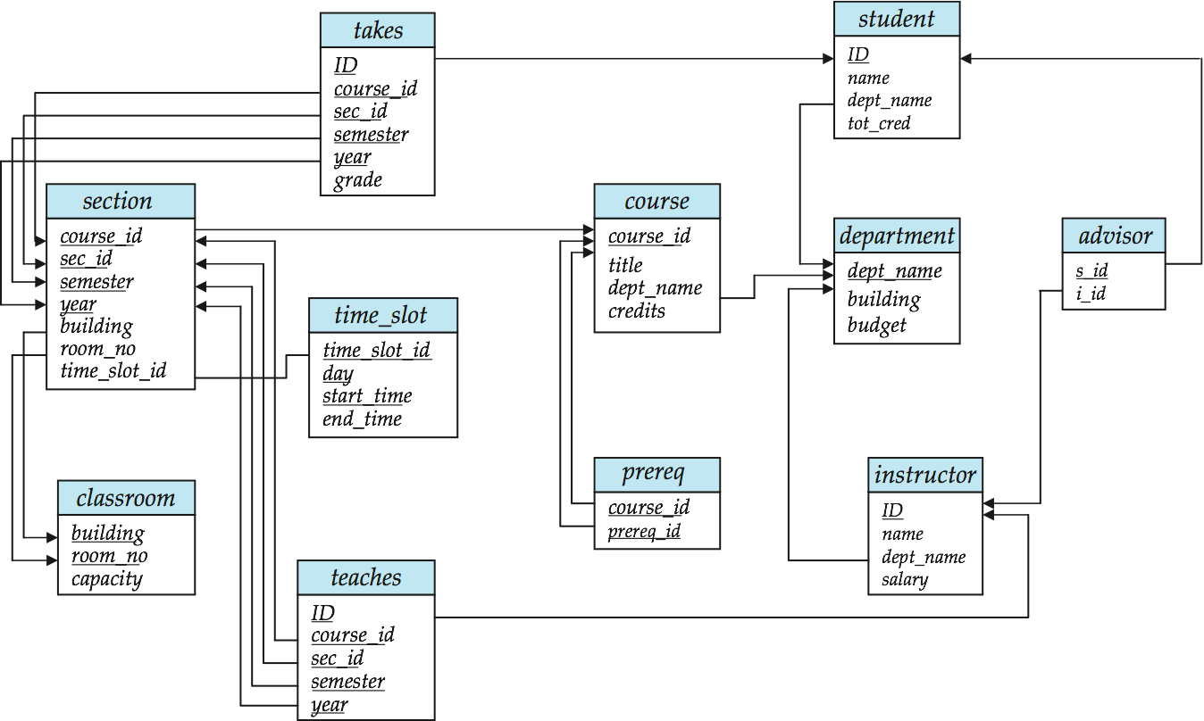
Schema
Schema referred in query examples.
Notes:
Schema referred in query examples.

Slide 4
The select Clause
The select clause list the attributes desired in the result of a query
corresponds to the projection operation of the relational algebra
Example: find the names of all instructors: select name from instructor;
NOTE: SQL names are not case-sensitive (i.e., you may use upper- or lower-case letters.)
Notes:
3
SQL> set linesize 200 - this will change the line width to 200 characters.
SQL> set pagesize 30 - this will change the page size to 30 rows.
SQL> set pause on - this will cause the output to pause every 30 lines; press the enter key to continue.
SQL> column column_name format a30
SQL> set linesize 300
The column command would make the display limited to 30 chars only.
Also the linesize would widen the display.

Slide 5
The select Clause (Cont.)
SQL allows duplicates in relations as well as in query results.
To force the elimination of duplicates, insert the keyword distinct after select.
Find the names of all departments with instructor, and remove duplicates.
select distinct dept_name from instructor ;
The keyword all specifies that duplicates not be removed. select all dept_name from instructor ;
Notes:
4
SQL> select distinct deptno from emp;
DEP
---
D1
D3
D2
SQL> select all deptno from emp;
DEPTNO
---
D1
D2
D3
D1
D2

Slide 6
The select Clause (Cont.)
An asterisk in the select clause denotes “all attributes”
select * from instructor ;
The select clause can contain arithmetic expressions involving the operation, +, –, ∗, and /, and operating on constants or attributes of tuples.
The query:
select ID, name, salary/12 from instructor ;
would return a relation that is the same as the instructor relation, except that the value of the attribute salary is divided by 12.
Notes:
5

Slide 7
The where Clause
The where clause specifies conditions that the result must satisfy
To find all instructors in Comp. Sci. dept with salary > 80000 select name from instructor where dept_name = 'Comp. Sci.' and salary > 80000
Comparison results can be combined using the logical connectives and, or, and not.
Comparisons can be applied to results of arithmetic expressions.
Find the instructors whose salary exceed 100000 after 10% increment
select name from instructor where Salary*1.1 >100000;
Notes:
6

Slide 8
The from Clause Cartesian Product
The from clause lists the relations involved in the query
Corresponds to the Cartesian product operation.
Find the Cartesian product instructor X teaches
select ∗ from instructor, teaches ;
generates every possible instructor – teaches pair, with all attributes from both relations.
Cartesian product not very useful directly, but useful combined with where-clause condition.
Notes:
8

Slide 9
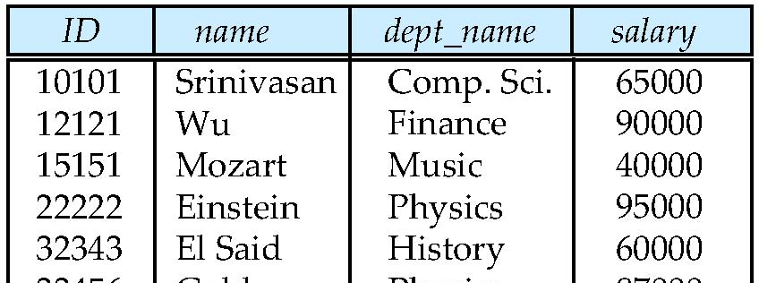
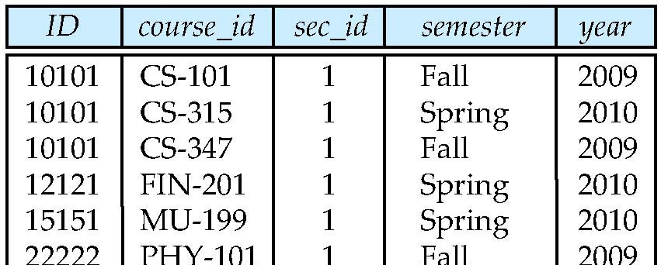
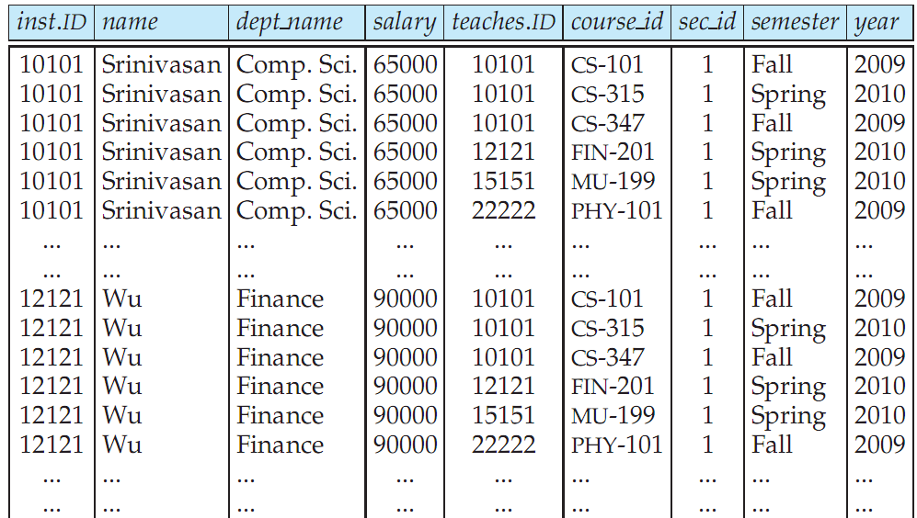
Cartesian Product: instructor X teaches
instructor
teaches

Slide 10
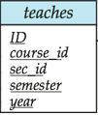

Joins
For all instructors who have taught some course, find their names and the course ID of the courses they taught.
select name, course_id from instructor, teaches where instructor.ID = teaches.ID;

Slide 11
Joins
Find the course ID, semester, year and title of each course offered by the Comp. Sci. department.
select section.course_id, semester, year, title from section, course where section.course_id = course.course_id and dept_name = 'Comp. Sci. ' ;

Slide 12
Natural Join (Cont.)
Danger in natural join: beware of unrelated attributes with same name which get equated incorrectly.
List Employee name, Department name of departments which they are working.
EMP |  | DEPT
empno |  | Dno
name |  | name
city |  | City
Deptno
Select Name, Dname from Emp NATURAL JOIN Dept;
This is incorrect.
Notes:
Select Name, Dname from Emp NATURAL JOIN Dept;

Slide 13
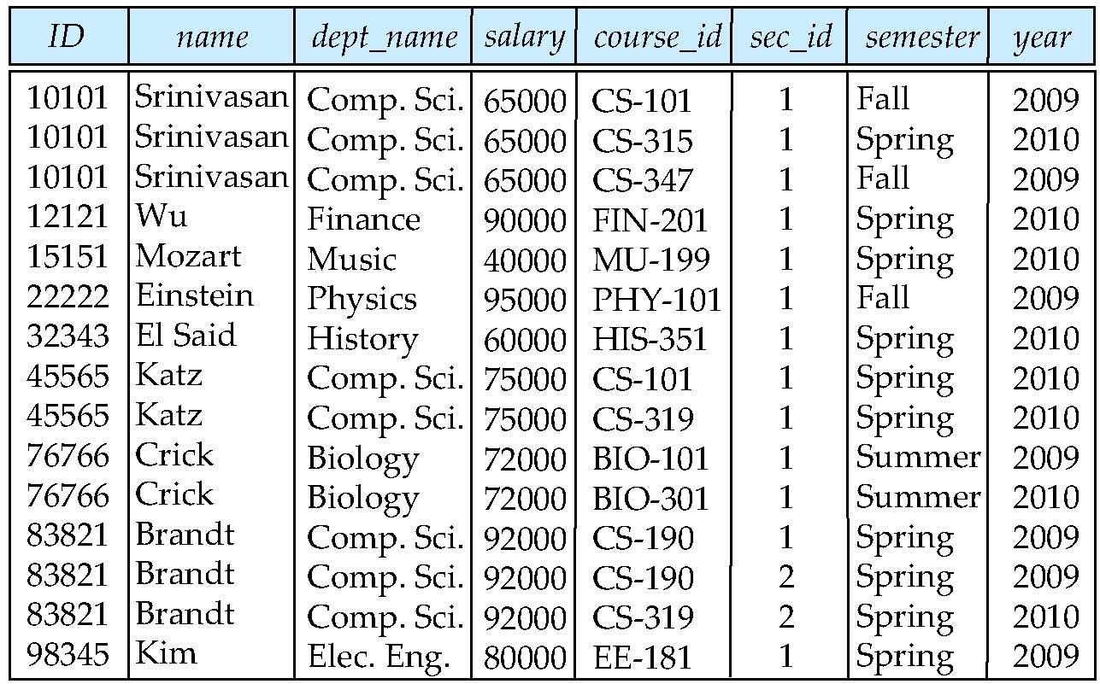
Natural Join
Natural join matches tuples with the same values for all common attributes, and retains only one copy of each common column.
select * from instructor natural join teaches ;

Slide 14
Natural Join Example
List the names of instructors along with the course ID of the courses that they taught.
select name, course_id from instructor, teaches where instructor.ID = teaches.ID;
OR
select name, course_id from instructor natural join teaches;
Notes:
select name, course_id from instructor join teaches using(id);

Slide 15
Three-Table Join
Consider the following table structure.
PROPERTYFORRENT (pno, street, area, city, pcode, type, rooms, rent, sno)
STAFF (sno, fname, lname, position, sex, DOB, salary, bno)
BRANCH (bno, street, city, postcode)
Example:
For each branch, list the staff who manage properties, including the city in which the branch is located and the properties they manage.
SELECT b.bno, b.city, s.sno, fname, lname, pno
FROM propertyForRent p, staff s, branch b
WHERE p.sno= s.sno AND s.bno= b.bno ;
Notes:
PROPERTYFORRENT (pno, street, area, city, pcode, type, rooms, rent, sno)
Pno- unique property number, Sno- unique staff number who manage the property.
Bno- unique id who works in a Branch

Slide 16
Computing a Join with other clauses DISTINCT,WHERE,ORDER BY
The procedure for generating the results of a SELECT with a join are as follows:
Form the Cartesian product of the tables named in the FROM clause.
If there is a WHERE clause, apply the search condition to each row of the product table, retaining those rows that satisfy the condition. In terms of the relational algebra, this operation yields a restriction of the Cartesian product.
For each remaining row, determine the value of each item in the SELECT list to produce a single row in the result table.
If SELECT DISTINCT has been specified, eliminate any duplicate rows from the result table.
If there is an ORDER BY clause, sort the result table as required.
Order of Keywords- from > where > group by > having > order by

Slide 17
Ordering the Display of Tuples
ORDER BY column1 [ASC|DESC],Column2 [ASC|DESC],..
List in alphabetic order the names of all instructors.
Example: select distinct name from instructor order by name;
We may specify desc for descending order or asc for ascending order, for each attribute; ascending order is the default.
Example: select distinct name from instructor order by name desc
Can sort on multiple attributes
Example: select distinct name from instructor order by dept_name asc , name desc
Order of Keywords- from > where > group by > having > order by
Notes:
The following is the priority of common SQL keywords
from > where > group by > having > order by
Partition by is applied after the above keywords. In fact, it is used to partition the result set after the selection

Slide 18
Outer Join
The join operation combines data from two tables by forming pairs of related rows where the matching columns in each table have the same value. If one row of a table is unmatched, the row is omitted from the result table.
Outer join include the unmatched rows in the result table.
Three types of outer join:
- Left
- Right
- Full

Slide 19
Join Example
BRANCH
PROPERTY
BranchNo
bCity
PropertyNo
pCity
B003
Glasgow
PA14
Aberdeen
B004
Bristol
PL94
London
B002
London
PG4
Glasgow
BranchNo
bCity
PropertyNo
pCity
B003
Glasgow
PG4
Glasgow
B002
London
PL94
London
In the example Branch b , property p, b and p are said to be Alias names to the tables branch & property respectively.
SELECT b.*, p.*
FROM branch b, property p
WHERE b.bcity = p.pcity;
Notes:
In the eaxmple Branch b , property p, b and p are said to be Alias names to the tables branch & property respectively.

Slide 20
Left Outer Join
Example:
List the branch offices and properties that are in the same city along with any unmatched branches.
SELECT b.*, p.*
FROM Branch b LEFT JOIN Property p ON
b.bcity = p.pcity;
Notes:
SQL> select a.id,name,b.id, course_id from instructor a left outer join teaches b ON a.id=b.id;

Slide 21
Result of Left Outer Join
BRANCH
PROPERTY
BranchNo
bCity
PropertyNo
pCity
B003
Glasgow
PA14
Aberdeen
B004
Bristol
PL94
London
B002
London
PG4
Glasgow
BranchNo
bCity
PropertyNo
pCity
B003
Glasgow
PG4
Glasgow
B004
Bristol
NULL
NULL
B002
London
PL94
London
SELECT b.*, p.*
FROM branch b
LEFT JOIN property p ON
b.bcity = p.pcity;
Notes:
Result of Left Outer Join

Slide 22
Right Outer Join
Example:
List the branch offices and properties in the same city and any unmatched property.
SELECT b.*, p.*
FROM Branch b RIGHT JOIN Property p ON
b.bcity = p.pcity;
Notes:
SELECT column_list FROM T1 RIGHT OUTER JOIN T2 ON join_predicate;
Here is how the RIGHT OUTER JOIN works.
Each row from the T1 table is compared with rows from the T2table:
If a pair of rows satisfies the join predicate, the column values of both rows are combined to make a result row that is then included in the result set.
In case a row in the T2 table does not match any row in the T1 table, the columns values from the row of the T2 table are combined with a NULL value for each column of the row from the T1 table to make the result row which is then also included in the result set.
In other words, a right outer join returns all rows from the right table and also the only matching rows from the left table.

Slide 23
Result of Right Outer Join
BRANCH
PROPERTY
BranchNo
bCity
PropertyNo
pCity
B003
Glasgow
PA14
Aberdeen
B004
Bristol
PL94
London
B002
London
PG4
Glasgow
BranchNo
bCity
PropertyNo
pCity
NULL
NULL
PA14
Aberdeen
B003
Glasgow
PL94
London
B002
London
PG4
Glasgow
SELECT b.*, p.*
FROM Branch b
RIGHT JOIN Property p ON
b.bcity = p.pcity;
Notes:
A right outer join returns all rows from the right table and also the only matching rows from the left table.

Slide 24
Full Outer Join
Example:
List the branch offices and properties that are in the same city and any unmatched branches or properties.
SELECT b.*, p.*
FROM branch b FULL JOIN property p ON
b.bcity = p.pcity;

Slide 25
Result of FULL Outer Join
BRANCH
PROPERTY
BranchNo
bCity
PropertyNo
pCity
B003
Glasgow
PA14
Aberdeen
B004
Bristol
PL94
London
B002
London
PG4
Glasgow
BranchNo
bCity
PropertyNo
pCity
NULL
NULL
PA14
Aberdeen
B003
Glasgow
PG4
Glasgow
B004
Bristol
NULL
NULL
B002
London
PL94
London
SELECT b.*, p.*
FROM branch b
FULL JOIN property p ON
b.bcity = p.pcity;
Notes:
SELECT select_list FROM T1 FULL OUTER JOIN T2 ON join_condition;

Slide 26
The Rename Operation
The SQL allows renaming relations and attributes using the as clause:
old-name as new-name
Renaming(Alias) to Columns
E.g.
select ID, name, salary/12 as monthly_salary from instructor;
Renaming(Alias) to Tables
Select A.ID From Instructor A WHERE A.Dept_Name=‘Comp. Sci.’;
Keyword as is optional and may be omitted instructor as T equivalent to instructor T
Keyword as may be omitted in Oracle
Notes:
9
Find the names of all instructors who have a higher salary than some instructor in ‘Comp. Sci’.
select distinct T. name from instructor as T, instructor as S where T.salary > S.salary and S.dept_name = ‘Comp. Sci.’

Slide 27
Compare Tuples in the Same Relation
Another reason to rename a relation is a case where we wish to compare tuples in the same relation. We then need to take the Cartesian product of a relation with itself.
Since we need to join a tuple of relation with another tuple in the same relation, It becomes impossible to distinguish one tuple from another without renaming.
Example: Find the names of all instructors who have a higher salary than some instructor in ‘Comp. Sci’. Instructor(ID,Name,Salary)
select distinct T. name from instructor T, instructor S where T.salary > S.salary and S.dept_name = ‘Comp. Sci.’
An identifier, such as T and S, that is used to rename a relation is referred to as a correlation name and is also commonly referred to as a table alias, or a correlation variable, or a tuple variable.
Notes:
An identifier, such as T and S, that is used to rename a relation
is referred to as a correlation name in the SQL standard, but is also commonly
referred to as a table alias, or a correlation variable, or a tuple variable.
SQL> select distinct T. name, t.salary ,S.name, s.salary from instructor T, instructor S
where T.salary > S.salary and S.dept_name = 'Comp. Sci.';
NAME SALARY NAME SALARY
-------------------- ---------- -------------------- ----------
Kim 80000 Srinivasan 65000
Kim 80000 Katz 75000
Wu 90000 Srinivasan 65000
Katz 75000 Srinivasan 65000
Singh 80000 Srinivasan 65000
Brandt 92000 Katz 75000
Singh 80000 Katz 75000
Gold 87000 Srinivasan 65000
Einstein 95000 Katz 75000
Gold 87000 Katz 75000
Crick 72000 Srinivasan 65000
NAME SALARY NAME SALARY
-------------------- ---------- -------------------- ----------
Wu 90000 Katz 75000
Einstein 95000 Srinivasan 65000
Brandt 92000 Srinivasan 65000
Einstein 95000 Brandt 92000

Slide 28
String Operations
SQL includes a string-matching operator for comparisons on character strings. The operator “like” uses patterns that are described using two special characters:
percent (%). The % character matches any substring.
underscore (_). The _ character matches any single character.
Find the names of all instructors whose name includes the substring “dhar”.
select name from instructor where name like '%dhar%’ ;
Notes:
Match the string “100 %” like ‘100 \%' escape character '\’
Need to check in Oracle
like 'ab∖%cd%' escape '∖' matches all strings beginning with “ab%cd”.
• like 'ab∖∖cd%' escape '∖' matches all strings beginning with “ab∖cd”.

Slide 29
String Operations (Cont.)
Patters are case sensitive.
Pattern matching examples:
‘Intro%’ matches any string beginning with “Intro”.
‘%Comp%’ matches any string containing “Comp” as a substring.
‘_ _ _’ matches any string of exactly three characters.
‘_ _ _ %’ matches any string of at least three characters.
SQL supports a variety of string operations such as
concatenation (using “||”)
converting from upper to lower case (and vice versa)
finding string length, extracting substrings, etc.
Notes:
SELECT FNAME || LANME FROM Persons;

Slide 30
Where Clause Predicates
SQL includes a between , Not Between comparison operator
Example: Find the names of all instructors with salary between $90,000 and $100,000 (that is, ≥ $90,000 and ≤ $100,000)
select name from instructor where salary between 90000 and 100000
This is equivalent to
select name from instructor where salary >=90000 and salry <=100000
Similarly NOT BETWEEN can also be used
Ex: ….. WHERE salary NOT BETWEEN 90000 and 100000
Notes:
7
Tuple comparison
select name, course_id from instructor, teaches where (instructor.ID, dept_name) = (teaches.ID, ’Biology’);

Slide 31
Set Operations-UNION
Display Employee names who are working in deptno 10 , 20.
Assume the schema EMP(empno,ename,sal,deptno)
SELECT Ename
FROM Emp WHERE deptno=10
UNION
SELECT Ename
FROM Emp WHERE deptno=20;
The query is equivalent to-
SELECT Ename
FROM Emp
WHERE deptno=10 OR deptno=20;
Notes:
In result displayed duplicates display is suppressed.

Slide 32
Set Operations-INTERESECT
Find the name of employees working in department –‘RESEARCH’ and drawing salary more than 2500.
Assume Emp(empno,ename,sal,deptno) & Dept(Deptno,Dname,City)
Emp.deptno is F.key referencing Dept.Deptno(p.key)
Select ename from emp,dept where emp.deptno=dept.deptno and dname='RESEARCH'
INTERSECT
Select ename from emp,dept where emp.deptno=dept.deptno and sal>2500;
This query is equivalent to - ?
Notes:
This query is equivalent to
Select ename from emp,dept where emp.deptno=dept.deptno and dname='RESEARCH’ AND sal>2500;

Slide 33
Set Operations- MINUS
Find ename and deptno from emp who are not working in deptno 20.
Select empno,ename,deptno from emp
MINUS
Select empno,ename,deptno from emp where deptno=20;
Notes:
Query 1 MINUS Query 2 means – retrieve rows only present in Query1 but not in QUery2
Select empno,ename,deptno from emp where deptno!=20; equivalent to above query

Slide 34

Set Operations
Find courses that ran in Fall 2009 or in Spring 2010
(select course_id from section where sem = ‘Fall’ and year = 2009) union (select course_id from section where sem = ‘Spring’ and year = 2010)
Find courses that ran in Fall 2009 and in Spring 2010
(select course_id from section where sem = ‘Fall’ and year = 2009) intersect (select course_id from section where sem = ‘Spring’ and year = 2010)
Find courses that ran in Fall 2009 but not in Spring 2010
(select course_id from section where sem = ‘Fall’ and year = 2009) minus (select course_id from section where sem = ‘Spring’ and year = 2010)

Slide 35
Set Operations
Set operations union, intersect, and Minus
Each of the above operations automatically eliminates duplicates
To retain all duplicates use the corresponding multiset versions union all.
Suppose a tuple occurs m times in r and n times in s, then, it occurs:
m + n times in r union all s

Slide 36
Null Values- is null
It is possible for tuples to have a null value, denoted by null, for some of their attributes
null signifies an unknown value or that a value does not exist.
The result of any arithmetic expression involving null is null
Example: 5 + null returns null
The predicate is null can be used to check for null values.
Example: Find all instructors whose salary is null.
select name from instructor where salary is null;

Slide 37
IS NULL/ IS NOT NULL
.
Example:
List the details of all staff who have only first name but not last name.
SELECT sno, fname, lname, salary
FROM staff
WHERE lname IS NULL AND fname IS NOT NULL;

Slide 38
Null Values and Three Valued Logic
Any comparison with null returns unknown
Example: 5 < null or null <> null or null = null
Three-valued logic using the truth value unknown:
OR: (unknown or true) = true, (unknown or false) = unknown (unknown or unknown) = unknown
AND: (true and unknown) = unknown, (false and unknown) = false, (unknown and unknown) = unknown
NOT: (not unknown) = unknown
Result of where clause predicate is treated as false if it evaluates to unknown
Notes:
“P is unknown” evaluates to true if predicate P evaluates to unknown
ASSUME SOME DATA IN emp;
EMPNO ENAME SAL DEPTNO
---------- ---------- ---------- ----------
7900 JAMES 950 30
7902 FORD 3000 20
7934 MILLER 1300 10
7999 RAJ 20
Sal for Raj, empno 7999 is NULL.
Example-1
SELECT ENAME FROM EMP WHERE SAL =2000 and DEPTNO IS NOT NULL;
1st condition NULL=2000 returns NULL
2nd condition Deptno IS NOT NULL is TRUE for all above records
WHERE condition i.e. WHREE NULL AND TRUE evaluates to FALSE for all records , so no rows are listed
Example-2
SELECT ENAME FROM EMP WHERE SAL =2000 or DEPTNO IS NOT NULL;
1st condition NULL=2000 returns NULL
2nd condition Deptno IS NOT NULL is TRUE for all above records
WHERE condition i.e. WHREE NULL OR TRUE evaluates to TRUE for all records , so all names are listed

Slide 39
Aggregate Functions
These functions operate on the multiset of values of a column of a relation, and return a value
avg: average value min: minimum value max: maximum value sum: sum of values count: number of values
Consider following relation to write sql queries(next slide)
Student(Rollo,Name,Mark1,Mark2,Attendance)
Notes:
Null values are ignored in calculation of avg,min.max,sum,count.

Slide 40
Student(RollNo,Name,Mark1,Mark2,Attendance)
AVG()
SELECT AVG(column_name) FROM table_name WHERE condition;
SELECT AVG(Mark1) FROM Student;
SUM()
SELECT SUM(column_name) FROM table_name WHERE condition;
SELECT SUM(Mark1) FROM Student;
COUNT()
SELECT COUNT(column_name) FROM table_name WHERE condition;
SELECT COUNT(RollNo) FROM Student;
MAX()
SELECT MAX(column_name) FROM table_name WHERE condition;
SELECT MAX(Mark1) FROM Student;
SELECT MIN(Mark1) FROM Student;
Notes:
SELECT COUNT(Name) FROM Student; counts duplicates also but not null values if present in Name column.
SELECT COUNT(DISTNCT Name) FROM Student; eliminates counting duplicate and also null values.

Slide 41
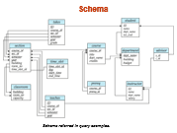
Aggregate Functions (Cont.)
Find the average salary of instructors in the Computer Science department
select avg (salary) from instructor where dept_name= ’Comp. Sci.’;
Find the total number of instructors who teach a course in the Spring 2010 semester
select count (distinct ID) from teaches where semester = ’Spring’ and year = 2010;
Find the number of tuples in the course relation
select count (*) from course;
Notes:
SQL> select * from emp;
EMPNO DNAME SAL DEP
---------- ---------------- ---------- ---
104 Ravi D2
105 Ravi 99899 D2
101 Raj 78899 D1
102 Ram 98899 D1
103 Rakesh 99899 D2
Count(*) counts number of records
SQL> select count(*) from emp;
COUNT(*)
----------
5
Assume there are 5 records in EMP , but Sal value is null for one of the record.
SELECT count(sal) FROM EMP; value returned is 4 , means null sal value not counted however duplicates also counted.
SQL> select count(sal) from emp;
COUNT(SAL)
----------
4
To avoid duplicates use DISTINCT
SELECT count (DISTINCT sal) FROM EMP; Both duplicate and null values not counted
SQL> SELECT count (DISTINCT sal) FROM EMP;
COUNT(DISTINCTSAL)
------------------
3
COUNT(*) function returns the number of items in a group, including duplicate values and NULL values.
SQL> select deptno,count(*) from emp group by deptno;
DEP COUNT(*)
--- ----------
D1 2
D2 3
However null values not counted in following case
SQL> select deptno,count(sal) from emp group by deptno;
DEP COUNT(SAL)
--- ----------
D1 2
D2 2

Slide 42
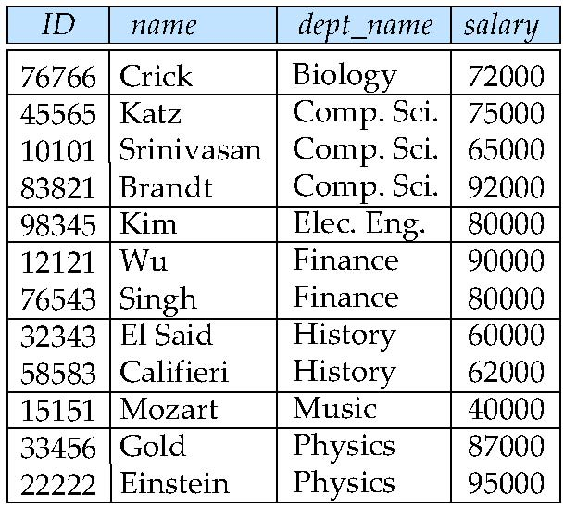
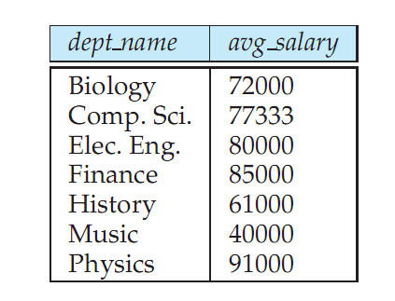
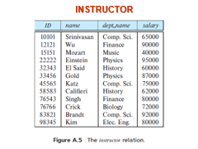
Aggregate Functions – Group By
Find the average salary of instructors in each department
select dept_name, avg (salary) from instructor group by dept_name;
Notes:
The following is the priority of common SQL keywords
from > where > group by > having > order by
Partition by is applied after the above keywords. In fact, it is used to partition the result set after the selection

Slide 43
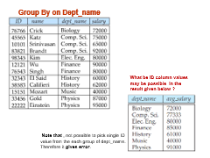

Aggregation (Cont.)
Apart from aggregate functions, attributes in select clause must be the attributes which appear in group by list only.
Instructor(ID, Name, Dept_Name, Salary)
/* erroneous query- Not Group By field */ select dept_name, ID, avg (salary) from instructor group by dept_name;
Notes:
Grouping considers all rows with null value in the grouping field as one group.

Slide 44
Aggregate Functions – Having Clause
Instructor(ID, Name, Dept_Name, Salary)
Find the department names and average salaries of all departments where average salary of departments is greater than 42000
select dept_name, avg (salary)
from instructor group by dept_name
having avg (salary) > 42000;
Note: predicates in the having clause are applied after the formation of groups whereas predicates in the where clause are applied before forming groups
Display the name and average salary of History , Comp Sc departments if their average salary is greater than 42000
Notes:
Display the name and average salary of History , Comp Sc departments if their average salary is greater than 42000
select dept_name, avg (salary)
from instructor where dept_name='Comp. Sci.' OR dept_name='History'
group by dept_name
having avg (salary) > 42000;

Slide 45
Null Values and Aggregates
Total all salaries
select sum (salary ) from instructor;
Above statement ignores null salary amounts
Result is null if there is no non-null amount
All aggregate operations except count(*) ignore tuples with null values on the aggregated attributes.
What if collection has only null values?
count returns 0
all other aggregates return null
Notes:
SQL> select * from t1;
A B C
---------- --- ----------
111 aaa
aaa
222 aaa 111
333 bbb 444
555
SQL> select count(*) from t1;
COUNT(*)
----------
6
SQL> select sum(c) from t1;
SUM(C)
----------
555
SQL> select avg(c) from t1;
AVG(C) // (111+444)/2=277.5
----------
277.5
Another example
SQL> select * from t1;
A B
---------- ----------
3 2
4
6 7
7
8
6 rows selected.
SQL> select count(A) from t1;
COUNT(A)
----------
4
SQL> select count(B) from t1;
COUNT(B)
----------
3
SQL> update t1 set b=null;
6 rows updated.
SQL> select count(B) from t1;
COUNT(B)
----------
0
SQL> select sum(b) from t1;
SUM(B)
----------

Slide 46
Nested Subqueries
SQL provides a mechanism for the nesting of subqueries.
A subquery is a select-from-where expression that is nested within another query.
A common use of subqueries is to perform tests for set membership, set comparisons, and set cardinality.

Slide 47
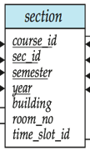
Example-set membership using IN
Find courses offered in the both semester-’Fall’ , year 2009 and in Spring, 2010
select distinct course_id
from section
where semester = ’Fall’ and year= 2009 and course_id IN (select course_id
from section
where semester = ’Spring’ and year= 2010);
Tested membership in a one-attribute relation
Inner query gives set of course_id = {CS-101, CS-315,CS-319,FIN-201,HIS-351,MU-199}
Outer Query gives set of course_id={CS-101,CS-347,PHY-101}
IN operator will; check-
CS-101 ϵ {CS-101, CS-315,CS-319,FIN-201,HIS-351,MU-199} ? If YES , CS-101 is the Result
Similarly for CS-347,PHY-101
ANY OTER WAYS to WRITE the QUERY?
Notes:
Another way : using INTERSECTION
select distinct course_id
from section
where semester = ’Fall’ and year= 2009 ; gives set of course_id={CS-101,CS-347,PHY-101}
select course_id
from section
where semester = ’Spring’ and year= 2010; gives set of course_id ={CS-101, CS-315,CS-319,FIN-201,HIS-351,MU-199}
Common element between both the sets gives the result of above query.

Slide 48
Section table data
Fall’ , year 2009 and in Spring, 2010
Inner query gives set of course_id = {CS-101, CS-315,CS-319,FIN-201,HIS-351,MU-199}
Outer Query gives set of course_id={CS-101,CS-347,PHY-101}
Notes:
CS-101,CS-347,PHY-101
CS-101, CS-315,CS-319,FIN-201,HIS-351,MU-199

Slide 49
set membership Example Query
Find courses offered in Fall 2009 but not in Spring 2010
select distinct course_id
from section
where semester = ’Fall’ and year= 2009 and course_id NOT IN (select course_id
from section
where semester = ’Spring’ and year= 2010);
NOT IN operator will; check-
CS-101 ∉ { CS-101, CS-315, CS-319, FIN-201, HIS-351, MU-199 } ?
If YES , CS-101 is the Result
Similarly for CS-347,PHY-101
Other way to write Query?
Notes:
Other way to write Query? Using MINUS
DISTINCT no needed in this example, however if Outer query returns duplicate values then we may need Distinct.
If During FALL 2009 if some course CS_101 is offered for another section at different Room_No then 2 times CS_101 appears in output, so we can use DISTINCT
select distinct course_id
from section
where semester = ’Fall’ and year= 2009 ; gives set of course_id={CS-101,CS-347,PHY-101}
select course_id
from section
where semester = ’Spring’ and year= 2010; gives set of course_id ={CS-101, CS-315,CS-319,FIN-201,HIS-351,MU-199}
Common element between both the sets gives the result of above query.

Slide 50
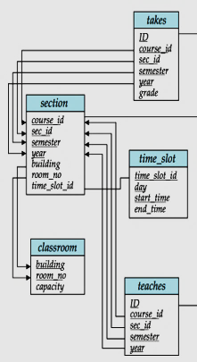
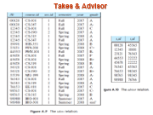
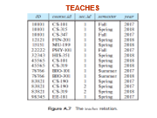
Example Query-IN ,order pairs
Find the total number of (distinct) students who have taken course sections taught by the instructor with ID 10101.
select count (distinct ID)
from takes
where (course_id, sec_id, semester, year) IN (select course_id, sec_id, semester, year
from teaches
where teaches.ID= 10101);
Test for membership to any relation
(group of attributes)
Notes:
Same Student ID might have taken more than one course taught by an Instructor, so such student ID appears multiple times and hence to avoid counting same student ID multiple times DISTINCT is used.
Note: Above query can be written in a much simpler manner. The formulation above is simply to illustrate SQL features.

Slide 51
Set Comparison
Find names of instructors with salary greater than that of some (at least one) instructor in the Biology department.
Notes:
In the above example there is only one instructor in Biology , but it is only coincident. The query will work even if multiple instructors are there in the instructor.
Set A={ Salary of instructors who are in Biology department } ={ 72000 } , there can be more than one instructors in Biology and hence more than one salary in the set.
Salary value of every tuple in instructors must be compared with the elements in the set A.

Slide 52
Set Comparison- some
Find names of instructors with salary greater than that of some (at least one) instructor in the Biology department.
select distinct T.name
from instructor T, instructor S
where T.salary > S.salary and S.dept_name = ’Biology’;
Same query using > some clause
select name
from instructor
where salary > some (select salary
from instructor
where dept_name = ’Biology’);
Notes:
The phrase “greater than at least one” is represented in SQL by > some.
The subquery:
(select salary
from instructor
where dept name = ’Biology’)
generates the set of all salary values of all instructors in the Biology department.
The > some comparison in the where clause of the outer select is true if the salary
value of the tuple is greater than at least one member of the set of all salary values
for instructors in Biology.

Slide 53
Definition of Some Clause
F <comp> some r ⇔ ∃ t ∈ r such that (F <comp> t ) Where <comp> can be: <, ≤, >, =, ≠
0
(5 < some
5
) = true
(read: 5 < some tuple in the relation)
6
0
(5 < some
5
) = false
0
(5 = some
) = true
5
0
(5 ≠ some
5
) = true (since 0 ≠ 5)
(= some) ≡ in
However, (≠ some) ≡ not in
SQL also allows < some, <= some, >= some, = some, and <> some comparisons.
Notes:
The phrase “greater than at least one” is represented in SQL by > some.

Slide 54
Example Query
Set Comparison- ALL
Find the names of all instructors whose salary is greater than the salary of all instructors in the Biology department.
select name
from instructor
where salary > all (select salary
from instructor
where dept_name = ’Biology’);

Slide 55
Definition of all Clause
The ALL comparison condition is used to compare a value to a list or subquery.
It must be preceded by =, !=, >, <, <=, >= and followed by a list or subquery.
0
(5 < all
5
) = false
6
6
(5 < all
) = true
10
4
(5 = all
) = false
5
4
(5 ≠ all
) = true (since 5 ≠ 4 and 5 ≠ 6)
6
(≠ all) ≡ not in
However, (= all) ≡ in
SQL also allows < all, <= all, >= all, = all, and <> all comparisons
Notes:
SQL also allows < all, <= all, >= all, = all, and <> all comparisons
The ALL comparison condition is used to compare a value to a list or subquery. It must be preceded by =, !=, >, <, <=, >= and followed by a list or subquery.

Slide 56
SQL> select empno, ename,sal,deptno from emp order by deptno;
EMPNO ENAME SAL DEPTNO
---------- ---------- ---------- ----------
7934 MILLER 10000 10
7782 CLARK 2450 10
7839 KING 5000 10
1000 DDD 3333 10
7566 JONES 2975 20
7369 SMITH 800 20
1001 EEEE 2005 20
7902 FORD 3000 20
7876 ADAMS 1100 20
7788 SCOTT 3000 20
7900 JAMES 950 30
7499 ALLEN 1600 30
7844 TURNER 1500 30
50 BBB 777 30
7521 WARD 1250 30
7698 BLAKE 2850 30
7654 MARTIN 1250 30

Slide 57
SQL> select sal,deptno from emp where deptno=20;
SAL DEPTNO
---------- ----------
2005 20
800 20
2975 20
3000 20
1100 20
3000 20
Find the Employee No, Sal and Deptno of employees who earn salary more than every employee in Dept 20 earn.
SQL> select empno,sal,deptno from emp where sal > ALL ( select sal from emp where deptno=20);
EMPNO SAL DEPTNO
---------- ---------- ----------
1000 3333 10
7839 5000 10
7934 10000 10

Slide 58
SET COMPARISION- using ALL & ALTERNATE WAY
Write the previous query by comparing salary of employees with maximum salary of employees in the department 20;
Select empno,sal,deptno from emp where sal >
Select max(sal) From Emp where deptno=20;
Notes:
SET COMPARISION- using ALL & ALTERNATE WAY

Slide 59
Test for Empty/Non-Empty Relations
The exists construct returns the value true if the argument subquery is nonempty.
exists r ⇔ r ≠ Ø non-empty
not exists r ⇔ r = Ø empty
Notes:
When you use a correlated subquery in a DELETE/UPDATE/SELECT statement, the correlation name represents the row that you want to delete. SQL evaluates the correlated subquery once for each row in the table named in the DELETE/UPDATE/SELECT statement to decide whether to delete/update/select the row.
Assume we have three tables
t1.columns: a,c t2.columns: a,b t3.columns: b,c,d
I want is to update t1.c with t3.d. But I can't just update t1 from t3 using t1.c = t3.c I also have to go though t3.b = t2.b and t1.a = t2.a.
If there is a one-to-many relationship between t1 and t2 or between t2 and t3 you will get many matches for each row in t1. If you know that all rows in t3 that belong to the same row in t1 have the same value in d, then you can use DISTINCT to remove (identical) duplicates.
UPDATE table t1 SET t1.c = (select t3.d from table3 t3, table2 t2 where t1.a = t2.a and t2.b = t3.b and t3.c = t1.c) WHERE EXISTS ( SELECT 1 FROM table1 t1, table2 t2 WHERE t1.a = t2.a and t2.b = t3.b and t3.c = t1.c)
UPDATE table1 t1 SET t1.c = (select MAX(t3.d) from table2 t2, table3 t3 where t2.b = t3.b and t1.a = t2.a) WHERE EXISTS ( SELECT 1 FROM table2 t2, table3 t3 WHERE t1.c = t3.c and t1.a = t2.a);

Slide 60
“Find all courses taught during both the Fall 2009 semester and in the Spring 2010 semester”
slide 42
Notes:
SQL> select course_id, semester,year from section where (semester='Fall' and year=2009) and course_id in (select course_id from section where semester='Spring' and year=2010);
same as given in slide 42

Slide 61
Correlation Variables-exists
Yet another way of specifying the query “Find all courses taught in both the Fall 2009 semester and in the Spring 2010 semester”
select course_id from section S where semester = ’Fall’ and year= 2009 and exists (select * from section T where semester = ’Spring’ and year= 2010 and S.course_id= T.course_id);
Correlated subquery -
Correlation name or correlation variable – S
Is there any other way to write the query ?
Notes:
The Query can be written – Using UNION.
When you use a correlated subquery in a DELETE/UPDATE/SELECT statement, the correlation name represents the row that you want to delete/select/update. SQL evaluates the correlated subquery once for each row in the table named in the DELETE/UPDATE/SELECT statement to decide whether to delete/update/select the row.
A table alias is also called a correlation name. A programmer can use an alias to temporarily assign another name to a table or column for the duration of a SELECT query.
select course_id,semester,year from section S where semester ='Fall' and year= 2009 and exists (select * from section T where semester = 'Spring' and year=2010 and S.course_id= T.course_id);
The above query also illustrates a feature of SQL where a correlation name
from an outer query (S in the above query), can be used in a subquery in the
where clause. A subquery that uses a correlation name from an outer query is
called a correlated subquery.
===================
Compare following query with the ‘exists’ given above.
select distinct course_id
from section
where semester = ’Fall’ and year= 2009 and course_id in (select course_id
from section
where semester = ’Spring’ and year= 2010);

Slide 62
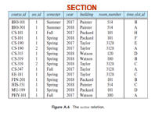
Correlation Variables-Exists
select course_id from section S where semester = ’Fall’ and year= 2009
Result is –
course_id={CS-101,CS-347,PHY-101}
select * from section T where semester = ’Spring’ and year= 2010
Result is-
{<CS-101,..>,< CS-315,…>,<CS-319,…>,<FIN-201,…>,<HIS-351,…>,<MU-199,…>}
and S.course_id= T.course_id);
CS-101=CS-101 YES, inner query return row(row exists satisfying)
CS-347=CS-101/CS-325/…./MU-199 NO, No row exists.
PHY-101= CS-101/CS-325/…./MU-199 NO, No row exists

Slide 63
General form of – Correlated Query
A correlated subquery is evaluated once for each row processed by the parent(outer) statement. The parent statement can be a SELECT, UPDATE, or DELETE statement.
SELECT column1, column2, ....
FROM table1 outer
WHERE column1 operator
(SELECT column1, column2
FROM table2
WHERE expr1 = outer.expr2 );
Product( Pname, CompName, Price, Qty)
Display Product name and Price of the product whose Price is more than the average price of all the products of each company)
Notes:
When you use a correlated subquery in a DELETE/UPDATE/SELECT statement, the correlation name represents the row that you want to delete. SQL evaluates the correlated subquery once for each row in the table named in the DELETE/UPDATE/SELECT statement to decide whether to delete/update/select the row.
Product( Pname, CompName, Price, Qty)
Display Product name and Price of the product whose Price is more than the average price of all the products of each company)
Select Pname, Price from product P where price>(Select avg(price) from Product Q where P.CompName=Q.CompName);
Update Product P set Price=Price- 0.2*Price where p.qty<(select avg(qty) from product Q where P. CompName=Q.CompName);

Slide 64
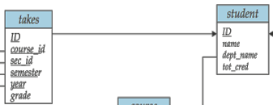
Correlation Variables-Not Exists
Find all students who have taken all courses offered in the Biology department.
All courses (ids) offered by
Biology Department
select distinct S.ID, S.name
from student as S
where not exists ( (select course_id
from course
where dept_name = ’Biology’)
MINUS
(select T.course_id
from takes as T
where S.ID = T.ID));
Courses (Ids) taken
by each student S
referred in the
outer query
Note that X – Y = Ø ⇔ X ⊆ Y
Notes:
Note: Cannot write this query using = all and its variants
{ All courses offered by Biology department } MINUS { All Courses Taken by a student referred in the Outer Query }

Slide 65
Courses
BIO-101,BIO-301,BIO-399 are the course offered by Biology department
Notes:
BIO-101,BIO-301,BIO-399 Courses

Slide 66
BIO-101,BIO-301,BIO-399 are the course offered by Biology department
Find all the courses taken by each student in Student relation , e.g. 00128 has taken CS-101,CS-347
{BIO-101,BIO-301,BIO-399} MINUS {CS-101,CS-347}= NOT EMPTY set means Student has not
taken not even one course Offred by the Biology department.
Notes:
{a,b,c} – {a,c,e} ={b}

Slide 67

Subqueries in the FROM Clause
SQL allows a subquery expression to be used in the from clause.
Find the average instructors’ salaries of those departments where the average salary is greater than $42,000.
select dept_name, avg_salary from (select dept_name, avg (salary) avg_salary from instructor group by dept_name) where avg_salary > 42000;
Note that we do not need to use the having clause
Notes:
select dept_name, avg_salary from (select dept_name, avg (salary) avg_salary from instructor group by dept_name) where avg_salary > 42000;
select deptno,avg_sal from (Select deptno,avg(sal) avg_sal From emp group by deptno ) where avg_sal>2000;
select deptno,avg_sal from (Select deptno,avg(sal) avg_sal From emp group by deptno ) dept_avg(deptno,avg_sal) where avg_sal>2000;
Another way to write above query ????
select dept_name, avg_salary from (select dept_name, avg (salary) from instructor group by dept_name) dept_avg (dept_name, avg_salary) where avg_salary > 42000;
?????
select dept_name, avg_salary from (select dept_name, avg (salary) avg_salary from instructor group by dept_name) dept_avg (dept_name, avg_salary) where avg_salary > 42000;

Slide 68
WITH Clause
The WITH clause provides a way of defining a temporary relation whose definition is available only to the query in which the WITH clause occurs.
Find all departments with the maximum budget with max_budget (value) as ( select max(budget) from department ) select dept_name,budget from department, max_budget where department.budget = max_budget.value;
Syntax: WITH query_name AS ( SQL query ) SELECT * FROM query_name;
Notes:
with max_sal(value) as (select max(sal) From emp)
select sal from emp, max_sal where emp.sal=max_sal.value;
with clause in the query defines the temporary relation max budget containing the
results of the subquery defining the relation. The relation is available for use only within
later parts of the same query.
with max_sal(deptno,value) as (select deptno,max(sal) from emp group by deptno) select dname,value from dept,max_sal where dept.dno=max_sal.deptno;
Find all the department and budgets if their budget is lesser than budget of Biology department.
with Bio_budget (value) as
( select budget
from department where dept_name='Biology')
select dept_name,budget
from department, Bio_budget
where department.budget <Bio_budget.value;
*Find name of departments in which total salary amount is lesser than 10% of Budget.
with Sum_sal(deptno,value) as (select deptno,Sum(sal) from emp group by deptno) select dname,Budget from dept, sum_sal where value<Budget*0.1;

Slide 69
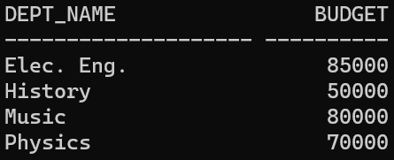
WITH Clause
Find all the department and budgets if their budget is lesser than the budget of Biology department.
WITH Bio_budget (value) as
( select budget
from department where
dept_name='Biology')
select dept_name,budget
from department, Bio_budget
where department.budget < Bio_budget.value;
General form
WITH R as (<Query involving R>)
<Query involving R>;

Slide 70
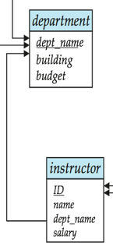
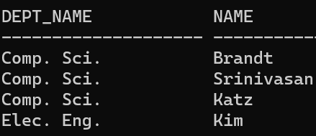
WITH Clause
Find all the instructor’s name who are working in departments which under Taylor building.
WITH Dept_Names (DName) as
( select Dept_name
from department where building='Taylor')
select dept_name,Name
from Instructor, Dept_Names
where Dept_Names.Dname=Instructor.Dept_name;

Slide 71
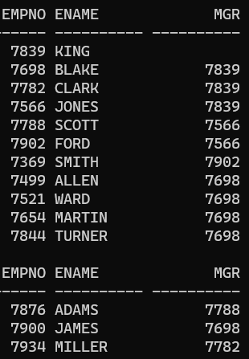
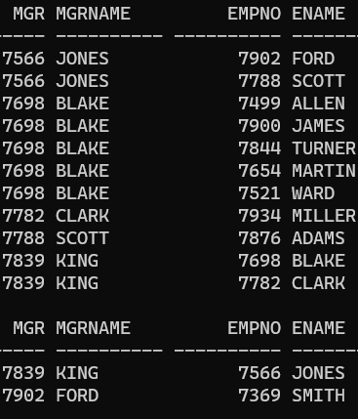
WITH Clause
SQL> SELECT EName , Empno, Mgr FROM EMP;
SQL> select e1.mgr,e2.ename mgrName ,e1.empno ,e1.ename Ename
2 from emp e1, emp e2 where e1.mgr=e2.empno;
Data in Emp(Empno,Ename,Mgr) table
Display each Manger detail and employee details who report to the manger.
Notes:
Data in Emp(Empno,Ename,Mgr) table
Dipslay each employee number and to whom they report.

Slide 72
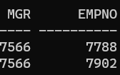
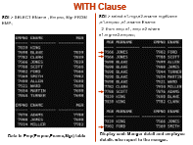
WITH Clause
Find all the employees who reports to Manager with employee id 7566
What if we want to find out who are all under manger 7655(i.e. who are all directly or indirectly report to 7566)
MGR EMPNO
---------- ----------
7566 7902
7788 7876
7902 7369
7566 7788
SQL> SELECT e.MGR, e.EMPNO
2 FROM EMP e
3 WHERE e.MGR = 7566;
*This output is the rows indicated
by arrow in previous slide
If this is the nature of output displayed, then we need to apply left side query recursively.
7566
7902
7788
7369
7876
Notes:
Find all the employees who reports to Manager with employee id 7566
If this is the nature of output displayed, then we need to apply left side query recursively
What if we want to find out who are all under manger 7655(i.e. who are all directly or indirectly report to 7566)
Arrow indicating rows in previous slide

Slide 73
Recursive Query-WITH Clause
Recursive query is applied to query hierarchical data using recursive subquery factoring. Recursion is implemented in standard SQL-99 using Common Table Expressions (CTEs).
A CTE can be thought of as a named temporary table within a SQL statement that is retained for the duration of that statement.
A CTE is defined at the beginning of a query using the WITH clause.
There can be multiple CTE and each CTE must have Unique name.
In general, in recursion there has to be seed and recursion stopping criteria.
WITH R as (<Base Query > /*base member*/
UNION ALL
<Recursive Query involving R>); /* recursive member references R*/
<Query involving R>;
Any recursive view must be defined as the union of two subqueries: a base query that is nonrecursive and a recursive query that uses the recursive view. In
Notes:
Recursive query (also called in SQL as Common Table Expression-CTE) allows to name the result and reference it within other queries sometime later.
Oracle Database 11.2 introduced another method for accessing trees: recursive subquery factoring.

Slide 74
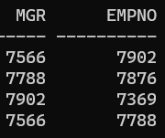
Example-Recursive Query(WITH Clause)
Find all the employees who reports directly or indirectly to the Manager with employee id 7566
WITH Empl_ReportTo_7566 (MGR, EMPNO) AS
(
SELECT e1.MGR, e1.EMPNO
FROM EMP e1
WHERE e1.MGR = 7566
UNION ALL
SELECT CHILD.MGR, CHILD.EMPNO
FROM Empl_ReportTo_7566 PARENT, EMP CHILD
WHERE PARENT.EMPNO = CHILD.MGR
)
SELECT DISTINCT MGR, EMPNO
FROM Empl_ReportTo_7566;
Notes:
WITH Empl_ReportTo_7566 (MGR, EMPNO) AS
(
SELECT e1.MGR, e1.EMPNO
FROM EMP e1
WHERE e1.MGR = 7566
UNION ALL
SELECT CHILD.MGR, CHILD.EMPNO
FROM Empl_ReportTo_7566 PARENT, EMP CHILD
WHERE PARENT.EMPNO = CHILD.MGR
)
SELECT DISTINCT MGR, EMPNO
FROM Empl_ReportTo_7566;
To display level along with above result
WITH Empl_ReportTo_7566 (MGR, EMPNO,lvl) AS
(
SELECT e1.MGR, e1.EMPNO, 1 lvl
FROM EMP e1
WHERE e1.MGR = 7566
UNION ALL
SELECT CHILD.MGR, CHILD.EMPNO , PARENT.lvl+1
FROM Empl_ReportTo_7566 PARENT, EMP CHILD
WHERE PARENT.EMPNO = CHILD.MGR
)
SELECT DISTINCT MGR, EMPNO,lvl
FROM Empl_ReportTo_7566;

Slide 75
CREATE .. AS.. SELECT… Create a table with the same schema as an existing table
Syntax:
CREATE TABLE <new_table_Name> AS SELECT <column1>,<column2>,… FROM <existing_table_name> WHERE <condition>;
Example:
Create a table Emp_Copy1 with the same schema as an existing Emp table:
CREATE TABLE Emp_Copy1 AS SELECT * FROM EMP;
Example:
Create a table Emp_Copy2 with columns Empno,Ename,Sal from an existing Emp table:
CREATE TABLE Emp_Copy2 AS SELECT Empno,Ename,Sal FROM EMP;
Notes:
Syntax: CREATE TABLE <new_table_Name> AS SELECT <column1>,<column2>,… FROM <existing_table_name> WHERE <condition>

Slide 76
CREATE .. AS.. SELECT… Create a table with the same schema as an existing table
Example:
Create a table Emp_Copy3 with columns Eno, Name, Salary by taking the column structure information from an existing Emp table:
CREATE TABLE Emp_Copy3(Eno, Name, Salary) AS SELECT Empno,Ename,Sal FROM EMP;
Create.. AS.. Select .. Command not only copies the structure of select copies but also copies data from those columns.
Example:
CREATE TABLE Emp_Copy3(Eno,Name,Salary) AS SELECT Empno,Ename,Sal FROM EMP WHERE Deptno=10;
Notes:
Example:
C

Slide 77
Scalar Subquery
The value of the scalar subquery expression is the value of the select list item of the subquery.
The subquery must return only one tuple containing a single attribute.
If the subquery returns 0 rows, then the value of the scalar subquery expression is NULL .
If subquery returned more than one row then returns error.
select col1
, ...
, (scalar subquery 1) vcol1
, (scalar subquery 2) vcol2
, ...
from table;
Notes:
Scalar Subquery Characteristics
A scalar subquery returns exactly one row as output.
If the scalar subquery finds no match, it returns NULL.
If the scalar subquery finds more than one match, it returns an error.
select dept_name,
(select count(*)
from instructor
where department.dept_name = instructor.dept_name)
as num_instructors
from department;
as- is optional
Select dept_name,count(*) from instructor group by dept_name;
*
select dept_name , (select sum(salary) from instructor
where department.dept_name = instructor.dept_name)
Dept_Total_salary
from department;
Error
select dept_name , (select sum(salary),Count(*) from instructor
where department.dept_name = instructor.dept_name)
Dept_Total_salary,Count_Instr
Count_Instr
Works Fine
select dept_name , (select sum(salary) from instructor
where department.dept_name = instructor.dept_name)
Dept_Total_salary, (select count(*) from instructor
where department.dept_name = instructor.dept_name) Count_Instr
from department;

Slide 78
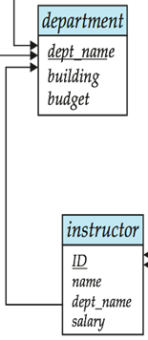
..Scalar Subquery
Find the name of department and number of instructors in each department.
select dept_name ,
(select count(*) from instructor
where department.dept_name = instructor.dept_name) num_instructors
from department;

Slide 79
..Scalar Subquery
Find the instructor name and corresponding department name in which instructor works.
select name ,
(select dept_name from department
where department.dept_name =
instructor.dept_name) Dname
from instructor ;
Notes:
select name ,
(select dept_name from department
where department.dept_name = instructor.dept_name) Dname
from instructor ;
SQL> select dept_name ,
(select name from instructor
where department.dept_name = instructor.dept_name) name_instructors
from department;
ERROR:
ORA-01427: single-row subquery returns more than one row
Because inner query returns more than one instructor name corresponding one department name , hence it gives error. Inner query must return one single tuple

Slide 80
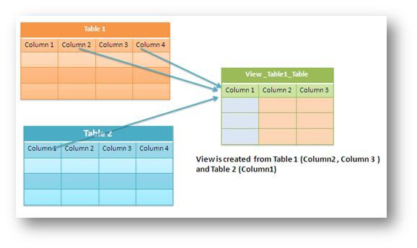
VIEWS
A view provides a mechanism to hide certain data from the view of certain users.
Any relation that is not of the conceptual model but is made visible to a user as a “virtual relation” is called a view.
Some times, it is not desirable for all users to see the entire logical model .
Thus Provides some kind of Security.
Notes:
In some cases, it is not desirable for all users to see the entire logical model (that is, all the actual relations stored in the database.)
Consider a person who needs to know an instructors name and department, but not the salary. This person should see a relation described, in SQL, by

Slide 81
View Definition
A view is defined using the create view statement which has the form
CREATE VIEW v AS < query expression >
where <query expression> is any legal SQL expression.
The view name is represented by v.
Once a view is defined, the view name can be used to refer to the virtual relation that the view generates.
View definition is not the same as creating a new relation by evaluating the query expression
Rather, a view definition causes the saving of an expression; the expression is substituted into queries using the view.

Slide 82
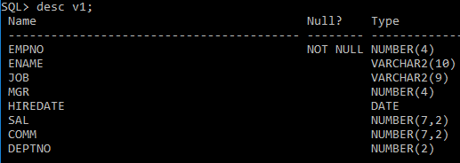
Example:
CREATE VIEW V1 AS SELECT * FROM Emp;

Slide 83
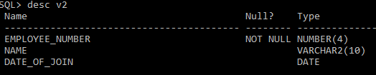
Example: Renaming column names in the View
CREATE VIEW V2 (employee_number, Name, Date_of_Join) AS SELECT empno, ename, hiredate FROM Emp;

Slide 84

Example: View with aggregate function
CREATE VIEW V3 AS SELECT job, avg(sal) Avg_sal FROM Emp GROUP BY job;

Slide 85
Views Defined Using Other Views
One view may be used in the expression defining another view
A view relation v₁ is said to depend directly on a view relation v₂ if v₂ is used in the expression defining v₁

Slide 86

Example: Creating a View from another view
CREATE VIEW v5 AS SELECT employee_number,name FROM v2 WHERE date_of_join>'17-DEC-1980';

Slide 87

Querying a View
Views can be queried in the same way like Base Tables
SQL> SELECT * FROM V5;
EMPLOYEE_NUMBER NAME
--------------- ----------
7499 ALLEN
7521 WARD
7566 JONES
7654 MARTIN
7698 BLAKE
7782 CLARK
7788 SCOTT
7839 KING
7844 TURNER
7876 ADAMS
7900 JAMES
Notes:
Views can be queries as if Base Tables

Slide 88
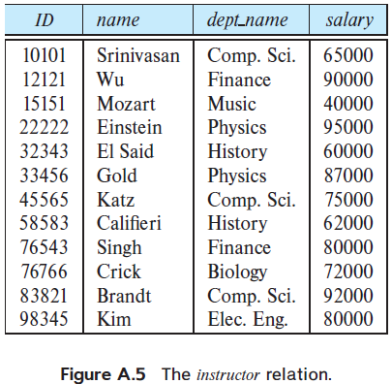
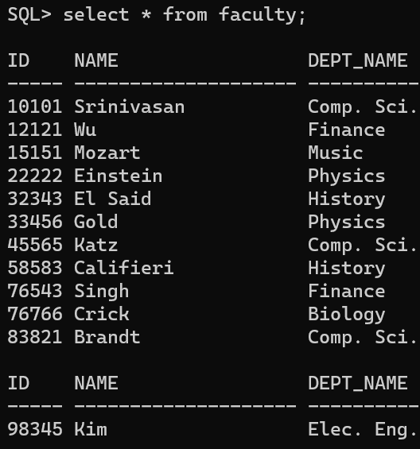
Create View faculty containing instructor id , name and department name of instructors.
CREATE VIEW faculty AS SELECT ID, Name, Dept_Name FROM Instructor;
Notes:
Create View faculty containing instructor id , name and department name of instructors.
CREATE VIEW faculty AS SELECT ID, Name, Dept_Name FROM Instructor;

Slide 89
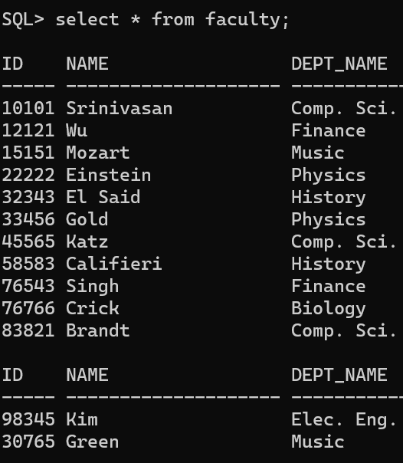
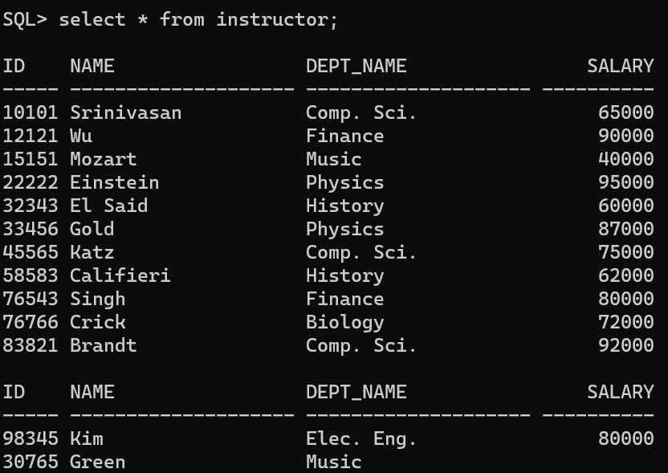
Update of a View
Add a new tuple to faculty view which we defined earlier
INSERT INTO faculty VALUES (’30765’, ’Green’, ’Music’);
This insertion must be represented by the insertion of the tuple
(’30765’, ’Green’, ’Music’, null) into the instructor relation

Slide 90
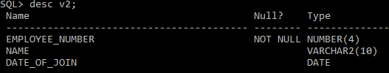
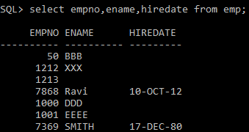
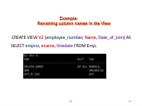
Update of a View
Insert a record into view v2 and check ,it is updateable view.?
insert into v2 values(7868,'Ravi','10-Oct-2012');
select empno,ename,hiredate from scott.emp;
Notes:
Insert a record into view v2 and check ,it is updateable view.?

Slide 91
Some Updates on views cannot be Translated Uniquely
Assume the following view is created-
create view instructor_info as select ID, name, building from instructor, department where instructor.dept_name= department.dept_name;
insert into instructor_info values (’69987’, ’White’, ’Taylor’);
which department, if multiple departments in Taylor?
what if no department is in Taylor?
Most SQL implementations allow updates only on simple views
The from clause has only one database relation.
The select clause contains only attribute names of the relation, and does not have any expressions, aggregates, or distinct specification.
Any attribute not listed in the select clause can be set to null, such column should not set with NOT NULL or PRIMARY KEY
The query does not have a group by or having clause.

Slide 92
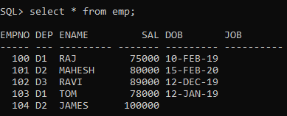
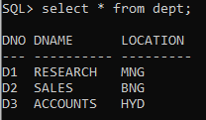
Example: VIEWS- Base tables- EMP & DEPT

Slide 93
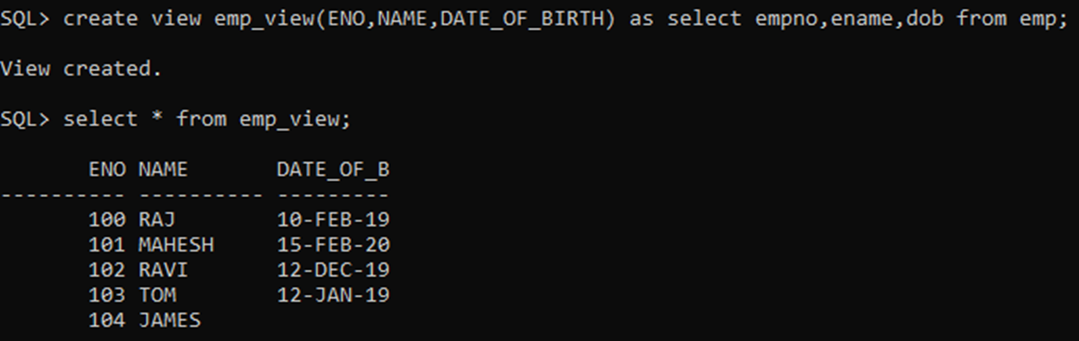
Creating- Updatable View
Create emp_view with fields ENO,NAME,DATE_OF_BIRTH by borrowing empno, ename, dob column definitions from EMP
CREATE VIEW emp_view(ENO,NAME,DATE_OF_BIRTH) AS SELECT empno, ename, dob FROM emp;
Notes:
Createing- Updatable View

Slide 94
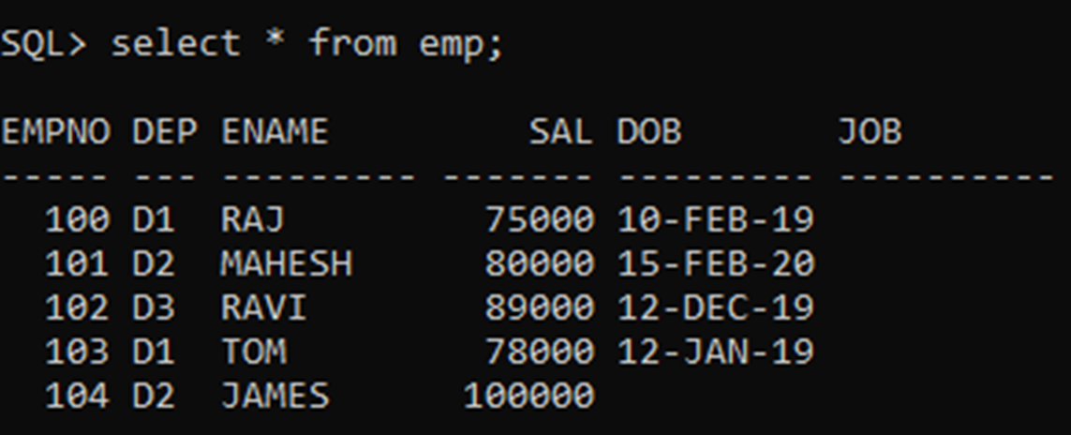

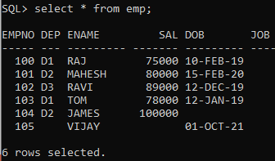
UPDATEABLE VIEW
Records in Base Table EMP Before updating View Emp_View
Updating Emp_View by adding one new record
Records in Base Table EMP After updating View Emp_View.
i.e. Updates on View also affects underlying Base table
Notes:
Records in Base Table EMP After updating View Emp_View
Updating Emp_View by adding one new record

Slide 95
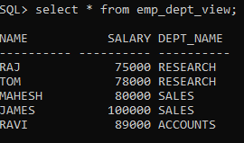
Example- Non Updateable View
Create a Emp_Dept_View( Name, Salary, Dept_Name) by borrowing column definitions- Ename,Sal from EMP and Dname from DEPT.
CREATE VIEW Emp_Dept_View (Name,Salary,Dept_Name) AS SELECT Ename,Sal,Dname FROM EMP,DEPT WHERE Deptno=Dno;

Slide 96
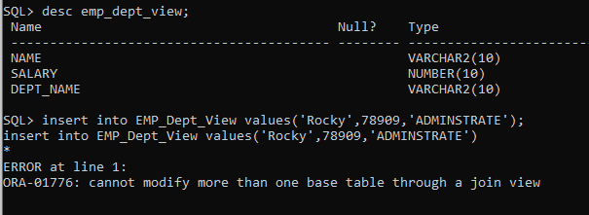
..Example- Non Updateable View
CREATE VIEW Emp_Dept_View (Name,Salary,Dept_Name) AS SELECT Ename,Sal,Dname FROM EMP,DEPT WHERE Deptno=Dno;

Slide 97
END

Slide 99
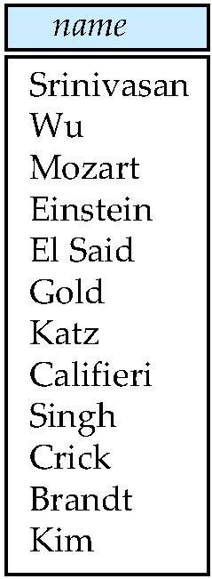
Figure 3.02

Slide 100
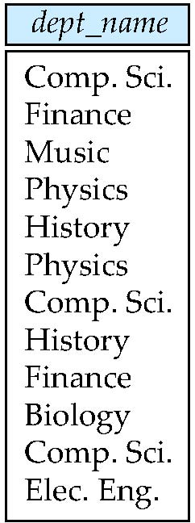
Figure 3.03

Slide 101

Figure 3.04

Slide 102
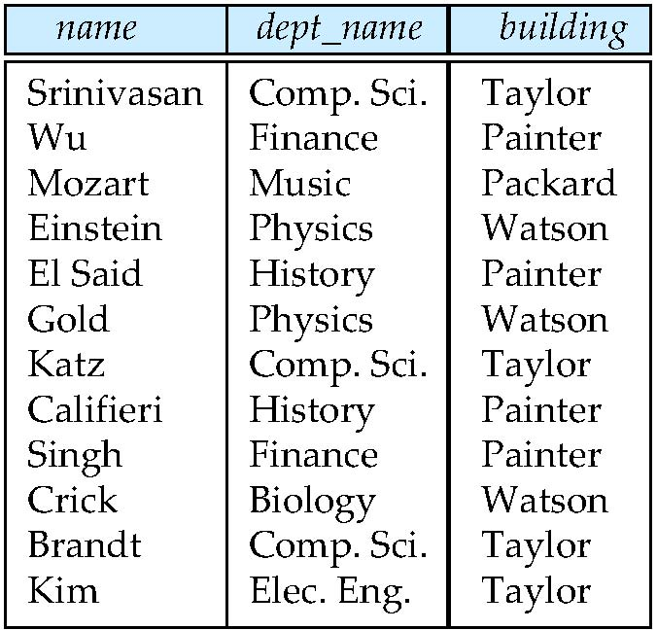
Figure 3.05

Slide 103
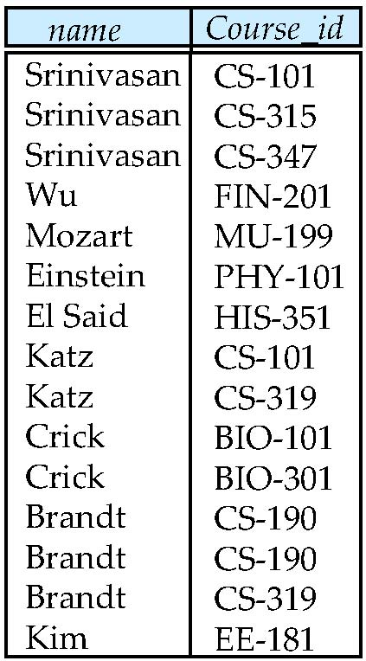
Figure 3.07

Slide 104
Figure 3.08

Slide 105
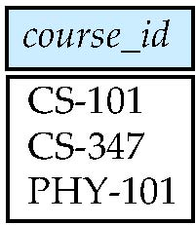
Figure 3.09

Slide 106
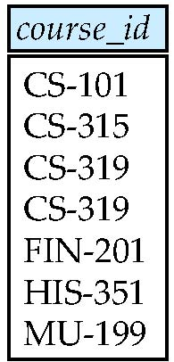
Figure 3.10

Slide 107
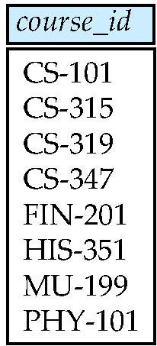
Figure 3.11

Slide 108

Figure 3.12

Slide 109

Figure 3.13

Slide 110

Figure 3.16

Slide 111

Figure 3.17

Slide 112
Schema & Sample Data

Slide 114



Slide 115


Slide 116
INSTRUCTOR

Slide 117

SECTION

Slide 118

TEACHES

Slide 119

STUDENT

Slide 120


Takes & Advisor

Slide 121


Time_Slot & PreReq

Slide 122


Slide 123
Group By on Dept_name
What be ID column values may be possible in the result given below ?
Note that , not possible to pick single ID value from the each group of dept_name. Therefore it gives error.
Notes:
What be ID column values may be possible in the result given below?
Note that , not possible to pick single ID value from the each group of dept_name.

